Slide 1
Anti-patterns
Pengembangan Sistem Berorientasi Obyek

Slide 2
The Origin
Christopher Alexander in the late 1970s.
  Architect
  A Pattern Language: Towns, Buildings, Construction
  The Timeless Way of Building
The approach consists of classic patterns tested in the real world and reviewed by multiple architects for beauty and effectiveness.

Slide 3
1994 OOPSLA
Object-Oriented Programming, Systems, Languages, and Applications
GOF (Gang of Four)
  Design Patterns: Elements of Reusable Object-Oriented Software
A recurring solution to a standard problem
Helps software developers communicate architectural knowledge and help developers learn a new design paradigm or architectural style.

Slide 4
Antipatterns
AntiPatterns: Refactoring Software, Architectures, and Projects in Crisis
Introduced in 1998
The authors describe and catalog negative problem solutions.
Purpose of cataloguing antipatterns is so they may be recognized and remedied or refactored or avoided.

Slide 5
Antipattern Overview
A design antipattern in an object-oriented program is an example of a design that initially appeared to be a good idea, but later turned out to be a bad one.
Antipatterns are examples of bad design and bad coding practice.

Slide 6
Specification/Analysis Antipatterns
Specifications are the basis for agreement between the user and developer of a software product.
The description of the software functionality is specified in the system specification and assists potential users in determining if the software will meet their needs.
Software should first and foremost satisfy its functional requirements.
The specification is typically used as a basis of the programmer’s contract with the client.

Slide 7
Specification/Analysis Antipatterns
Napkin specification:
  The functional or technical specifications are given to the developer informally or without sufficient detail.
  This is fundamentally equivalent to having no specification at all.

Slide 8
Specification/Analysis Antipatterns
Retro-specification:
  The functional or technical specifications are written after significant development effort or after the project has already gone live.

Slide 9
Specification/Analysis Antipatterns
Development team on a napkin:
  The project development organization is poorly defined with loose, ill-defined or non-existent project responsibilities.

Slide 10
Software Design Antipatterns
Software design is a crucial step in most software engineering processes.
Limited in scope (agile model) or targeted for an entire system (waterfall model), the design phase gives software engineers and architects the opportunity to accurately plan an effective solution to a problem and communicate this plan to others.
Communicating a design early in the software life cycle allows for review and the chance to identify potential issues sooner, saving time and cost of development.
Software designs are also a useful tool for education about the history of a solution.

Slide 11
Software Design Antipatterns
Gas factory:
  Overly complex or clever software designs lead to longer learning curves for other engineers involved with the project.
  Potentially more bugs, typically, overly complex bugs, are introduced into the software.
  The gas factory approach is used many times to keep others from questioning a design or to try to look clever in front of ones peers or management.
  Identifying this antipattern early will help avoid future unnecessary development costs.

Slide 12
Software Design Antipatterns
Big ball of mud:
  In this case a software design can go from unnecessarily complex to non existent.
  In this antipattern, the design of a system has no discernable architecture.
  This antipattern is often seen on projects where the design phase is limited or skipped due to time constraints or where the engineering team lacks experience.

Slide 13
Object-Oriented Design Antipatterns
The standard OO design idioms shared with students include design for flexibility, design for testability, employ component reuse, increase module cohesion, reduce module coupling, practice encapsulation, abstraction is our friend, prefer type (interface) inheritance over class inheritance, prefer composition to inheritance.

Slide 14
Object-Oriented Design Antipatterns
Sequential coupling:
Refers to a class that requires its methods to be called in a particular sequence.
This may be an antipattern, depending on the use.
Methods whose names begin with init, begin, start or second may indicate the existence of sequential coupling.

Slide 15
Object-Oriented Design Antipatterns
Yet another useless layer:
  Adding unnecessary layers to a program.
  As a rule, a layer is a simply connected fragment of a source code, which greatly improves the readability, flexibility or reuse of a program.
  The simple connectivity of layers may turn into a serious obstacle.
  A question to ask is “has the addition of layers been a victory for ease of programming or was it a victory for the programmer at the expense of end user?”.

Slide 16
Object-Oriented Design Antipatterns
God object:
  This is the object-oriented analogue of failing to use subroutines in procedural programming languages, or using far too many global variables to store state information.
  Instead of objects communicating among themselves, objects rely on the God object.
  Because the God object is referenced by so much of the other code, maintenance and debugging becomes more difficult than it otherwise would.
  The question to ask is, “Can you remove an object from the system without breaking every other object?” If not, they are too interdependent.

Slide 17
Programming Antipatterns
Computer science students are typically bombarded with a myriad of language specific guidelines for good programming practice by their texts and instructors.
The introduction of some general programming guidelines serves students well in seeing the bigger picture of program development.

Slide 18
Programming Antipatterns
Blind faith:
  This means that a programmer develops a solution or fixes a bug and deploys it without ever testing his creation or thinking through the ramifications of a change.
  The programmer in this situation has blind faith in his own abilities, but this often results in catastrophic failure or very obscure bugs.
  The primary purpose for testing is to detect software failures so that defects may be uncovered and corrected, and should never be overlooked.

Slide 19
Programming Antipatterns
Cargo cult programming:
  Is a style of computer programming, many times practiced by novice programmers, which is characterized by the ritual inclusion of code or program structures that serve no real purpose.
  Cargo cult programmers usually explain the useless code as a way of working around a computer bug encountered in the past.
  The programmer many times does not understand either the bug or the apparent solution

Slide 20
Programming Antipatterns
Accidental Complexity:
  Is a situation where the solution embodies a level of complexity that far outweighs that needed to solve the actual problem.
  Some levels complexity are inherent (essential complexity) while others are due to problem misunderstanding, absent or ineffective planning and lack of project priority.
  Novice programmers are many times taught to use prototypes to understand the problem that they face.
  With a prototype in hand, the programmer fails to clean up the design.
  Refactoring, rework, repair, redesign, and simplification must be an ongoing practice.

Slide 21
Methodological Antipatterns
Code reuse is one of the most broadly recognized phrases in today’s software engineering community.
The idea of not reinventing the wheel is both noble and necessary.
Discussed at a high level, software engineers should be encouraged to be experts in a domain and not in the enablers of that domain.

Slide 22
Methodological Antipatterns
Golden Hammer:
  This antipattern is also known through the expression, "When the only tool you have is a hammer, everything looks like a nail".
  It is important that the engineer be counseled that a particular solution is not necessarily appropriate for all problems.
  Education of new software engineers should include presenting multiple problems which require unique solutions.

Slide 23
Methodological Antipatterns
Copy and paste:
  This is where a coder copies a section of existing code to solve a current problem.
  Novice software engineers should be encouraged to appreciate the difficulty of maintaining multiple pieces of code that do the exact or similar functions.
  Using code out of context, where the copied code wasn’t meant for the current problem, should be discussed.

Slide 24
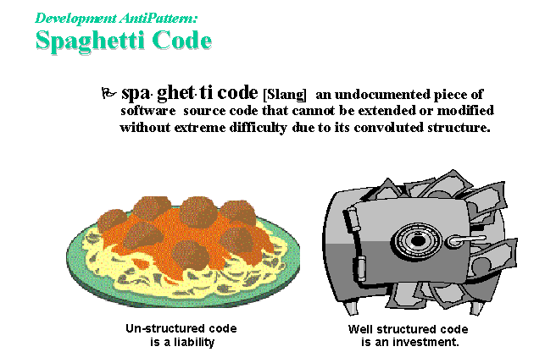

Slide 25
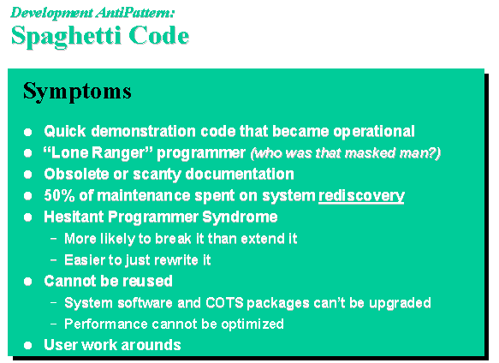

Slide 26
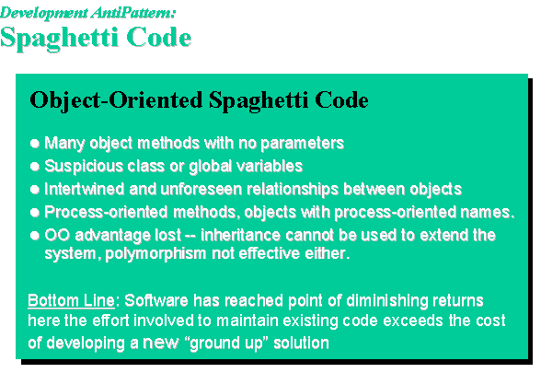

Slide 27
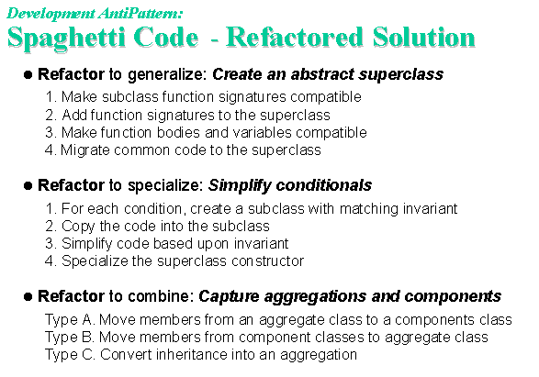

Slide 28
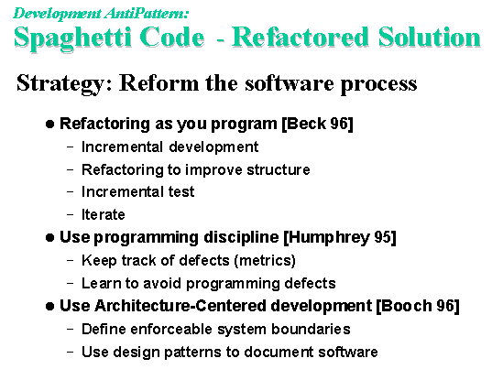

Slide 29
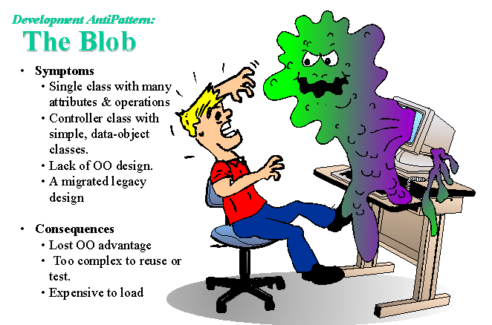

Slide 30
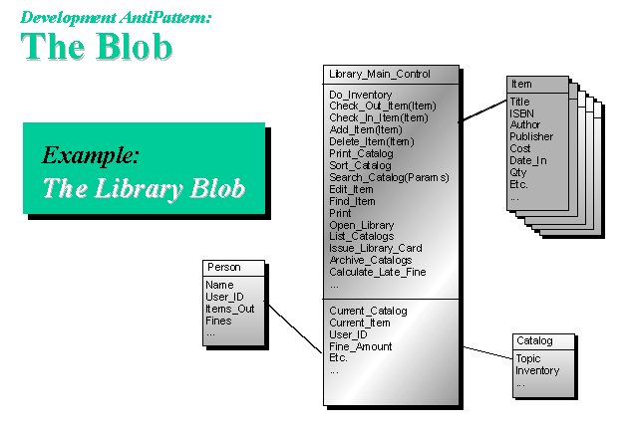

Slide 31
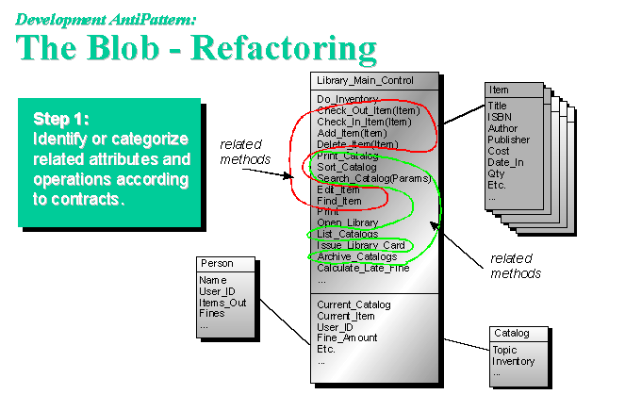

Slide 32
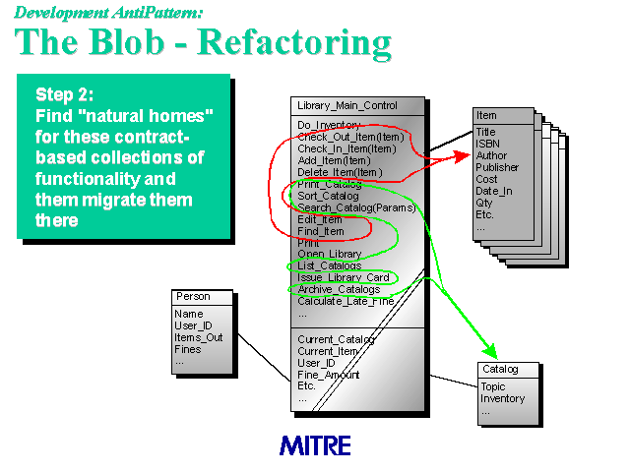

Slide 33
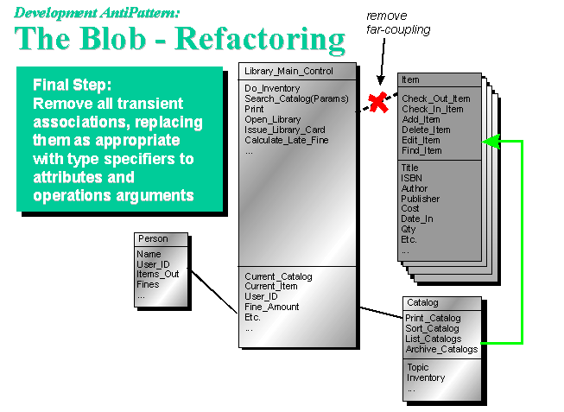

Slide 34
